Slide 1

[Eagle] Issue Report
Department Strategic Planning
Issued Date
2019.05.08

Slide 2
[Eagle] Issue Report_Shcedule
Category | Item | To do lists | Main | Target Date | Remark
Box | Gift Box | 2nd artwork sample shipping | FXN | 5/3 (FRI)
 |  | 2nd artwork (Design) sample SKB confirm | ALT | 5/9 (THU)
 |  | Apply for using android logo to google | FXN
 |  | Need to improvement of structure | FXN | 5/8
 |  | Package reliability test complete | FXN
 |  | Gift box approval (Final artwork release) | ALT
 | Carton Box | Apply for using android logo to google | FXN
 |  | Package reliability test complete | FXN
 |  | Carton box approval (Final artwork release) | ALT
Label | Device Label | Propose an improvement of printing specifications | FXN | 5/3 (FRI)
 |  | Provide sample (Improved design + barcode printing) | FXN | 5/14
 |  | SKB barcode reading test pass | ALT
 |  | Device label approval (Final artwork release) | ALT
 |  | Apply for using android logo to google | FXN
 | KC Certification Label | Provide artwork with power consumption and KC certification number | ALT | 5/27 (MON)
 |  | Provide sample with KC certification information | FXN
 |  | SKB confirm | ALT
 |  | KC certification label approval | ALT
 | Gift Box Label | Provide sample for barcode printing | FXN
 |  | SKB barcode reading test pass | ALT
 |  | Gift box label approval (Final artwork release) | ALT
 | Carton Box Label | Provide sample for barcode printing | FXN
 |  | SKB barcode reading test pass | ALT
 |  | Carton box label approval (Final artwork release) | ALT
Manual | User Manual | Provide artwork 3rd artwork | ALT |  | Need to discuss
 |  | Provide sample for 3rd artwork | FXN
 |  | 3rd artwork sample SKB confirm | ALT
 |  | Gift box approval (Final artwork release) | ALT
MD | STB Slant | Tooling modification for T2 | FXN | 5/8 (WED)
 | USB socket part | Fundamental countermeasure: mold modification for T2 | FXN | 5/8 (WED)
 | LED color | Need to prepare how to improve the LED uniformity with schedule | FXN
After ALT confirms the final sample
After ALT confirms the final sample
After ALT confirms the final sample
After ALT confirms the final sample
FXN won’t re-provide KC label
SKS is still insisting this sample?
SKS is still insisting this sample?

Slide 3
The DVT Samples

Slide 4
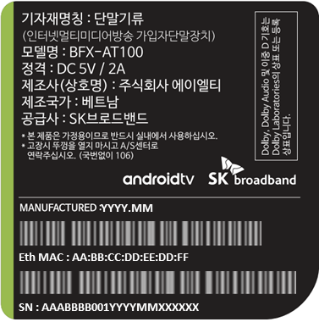
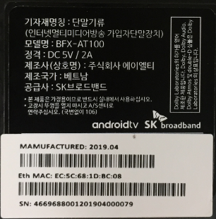
[Eagle] Issue Report_Packaging
2019.05.08 v0.4
○ Open ◑ Improving ● Closed
Category |  |  | Issue
No. | Item | Version | Image | Contents | Assignment | Status | Reference
01 | Label | DVT |  | Issue : Barcode print issue Temporary plan : Add White label Next Actions: Improve the print | FXN | ○ | Improved sample with barcode 5/14 Sending to ALT
Design
DVT
VN shall receive sample by 5/13
VN shall send sample with barcode by 5/14

Slide 5
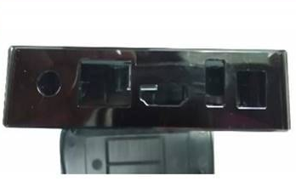
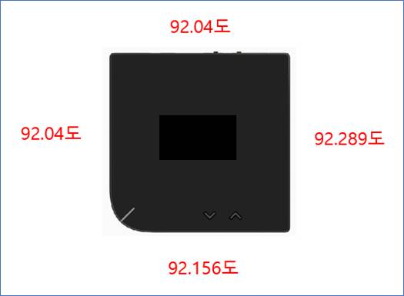
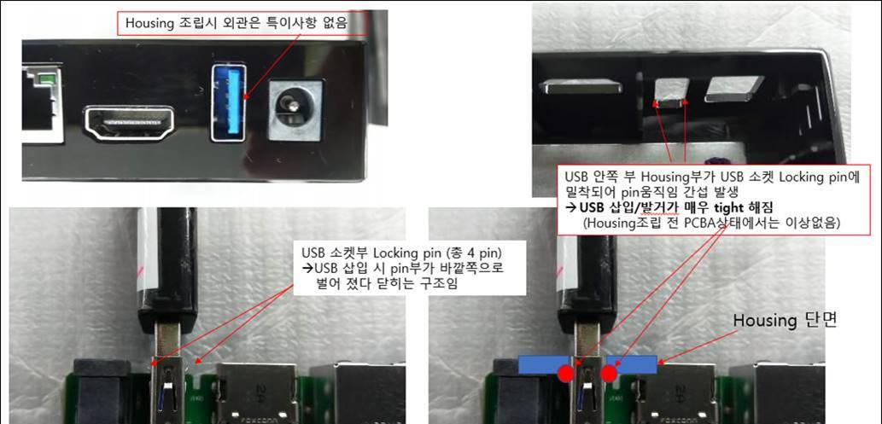
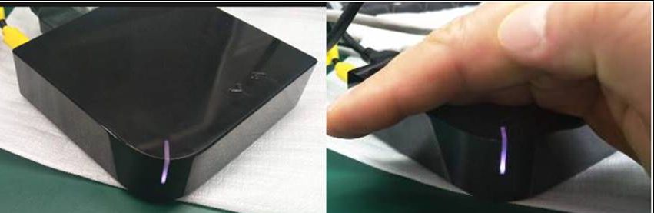
[Eagle] Issue Report_MD
2019.04.30 v0.3
○ Open ◑ Improving ● Closed
Category |  |  | Issue
No. | Item | Version | Image | Contents | Assignment | Status | Reference
01 | MD | DVT |  | Issue : STB looks like a slant Spec: 91.5+/-0.2 (DVT Sample spec out: 92.04 ~ 92.29) Next Actions: Tooling modification (Max 91.7, by T2 samples) | FXN | ○ | Required vendor to improve. Will improve from next tooling sample.
02 | MD | DVT |  | Issue : USB insertion and ignition difficult after case assembly Next Actions: 1) Temporary Measures: USB Hall Booze Cutting for DVT samples 2) Fundamental countermeasure: mold modification for T2 | FXN | ○ | Will modify USB connector position on PCBA to solve the stand out issue and plug-in/plug-out issue
03 | LED | DVT |  | Issue : LED lighting Uniformity and color is not matching Spec: White/Red/Green (ex: White looks like purple color) Next Actions: Need to prepare how to improve the LED uniformity with schedule | FXN | ○ | Will modify light pipe from next tooling sample. Have checked to color is the same on PCBA only.
T2 sample shall be ready by 5/17
PCBA shall be ready by 5/31
Sean will update on Mantis#542

Slide 6
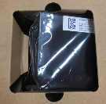
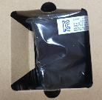
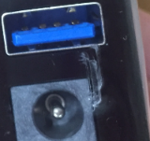
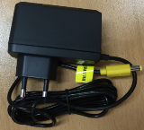
[Eagle] Issue Report_Packaging
2019.04.30 v0.3
○ Open ◑ Improving ● Closed
Category |  |  | Issue
No. | Item | Version | Image | Contents | Assignment | Status | Reference
01 | Gift Box | DVT |  | Issue : a structural weakness Next Actions: Need to improve package structure | FXN | ○ | Will improve box structure
02 | Plastic bag | DVT |  | Issue : Plastic bag Damage Next Actions: | FXN | ○ | Will remove plastic bag carefully during assembly
03 | Adapter | DVT | DVT | Issue : Missing packaging Next Actions: Plastic bag packing application | FXN | ○ | Need ALT to make the same package rule for two vendors. FXN will package ADP as what we receive
Confirm the new structure on 5/8
From next production
From next production

Slide 7
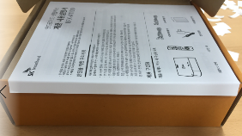


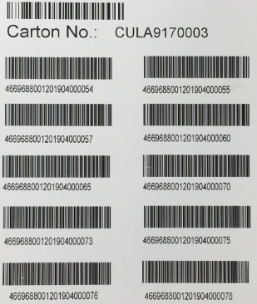
[Eagle] Issue Report_Packaging
2019.04.30 v0.3
○ Open ◑ Improving ● Closed
Category |  |  | Issue
No. | Item | Version | Image | Contents | Assignment | Status | Reference
04 | Manual | DVT |  | Issue : folding manual | FXN | ○ | Will package it more carefully
05 | Manual | DVT |  | Issue : Poor print quality | FXN | ○ | Required vendor to improve it [ALT] Provide the final artwork by 5/10
06 | Packing | DVT |  | Issue : Packaging order is not serial number order | FXN | ○ | Normally it will be packaged in sequence. We have mix ALT q'ty and FXN q'ty together on this DVT production.
From next production
1st sample
2nd sample
Will prepare the final sample after receiving the final artwork
From next production

Slide 8
The 1st Sample of Gift Box

Slide 9






[Eagle] Issue Report
2019.04.15 v0.1
○ Open ◑ Improving ● Closed
Category |  |  | Issue
No. | Item | Version | Image | Contents | Assignment | Status | Reference
01 | Gift Box | 1st sample |  | Issue : Insufficient printing area Improvement : Orange print area expansion required Applying improvement to design artwork v0.4 ([Eagle_BFX-AT100] Gift_Box_Design_v0.4_190412) | ALT | ◑ | 01. Eagle_gift box_upper side.jpg
 |  |  |  |  |  |  | AT100(Android)] Gift_Box_Design_v0.4_190412
02 | Gift Box | 1st sample |  | Issue : Poor print quality Improvement : | FXN | ○ | 02. Eagle_gift box_bottom_icon.jpg
03 | Gift Box | 1st sample |  | Issue : Poor print quality Improvement : | FXN | ○ | 03. Eagle_gift box_upper side_text.jpg

Slide 10


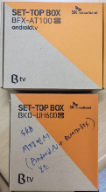
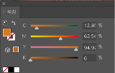

[Eagle] Issue Report
2019.04.15 v0.1
○ Open ◑ Improving ● Closed
Category |  |  | Issue
No. | Item | Version | Image | Contents | Assignment | Status | Reference
04 | Gift Box | 1st sample |  | Issue : Missing printing Improvement : | FXN | ○ | 04. Eagle_gift box_side_label_attachment_guideline.jpg
05 | Gift Box | 1st sample |  | Issue : Color difference compared to comparative model Improvement : Applying improvement to design artwork v0.4 Color change with PANTONE 158C Applying improvement to design artwork v0.4 ([Eagle_BFX-AT100] Gift_Box_Design_v0.4_190412) | ALT | ◑ | 05. Eagle_gift box_color_comparison.jpg
 |  |  |  |  |  |  | [Eagle_BFX-AT100(Android)] Gift_Box_Design_v0.4_190412
Design artwork
1st sample
1st sample
Reference

Slide 11


Thank you.

